Slide 1
Developing revenue increasing strategies for a Database Engineer of a computer hardware company
Name: Manoj
Roll number: 23ds2000018
IITM Online BS Degree Program

Slide 2
Introduction and Objectives
The main business problem here is to basically develop methods to increase the sales and revenue of these HP products that can be easily interpreted by a backend database engineer. By developing these methods, the backend database team could procure data in a more effective way and make the company concentrate more resources, inventory space, and marketing on a particular group.
Objective 1: Customer Segmentation: Use the product sales data to segment customers based on their geographical location and product categories.
Objective 2: Demand Forecasting: Utilize the historical sales data, including units sold, revenue, and product attributes, to forecast future demand for different product categories or segments.
Objective 3: Customer Lifetime Value (CLV) Analysis: involves estimating the total value a customer is expected to bring to your business over their entire relationship with your company.

Slide 3
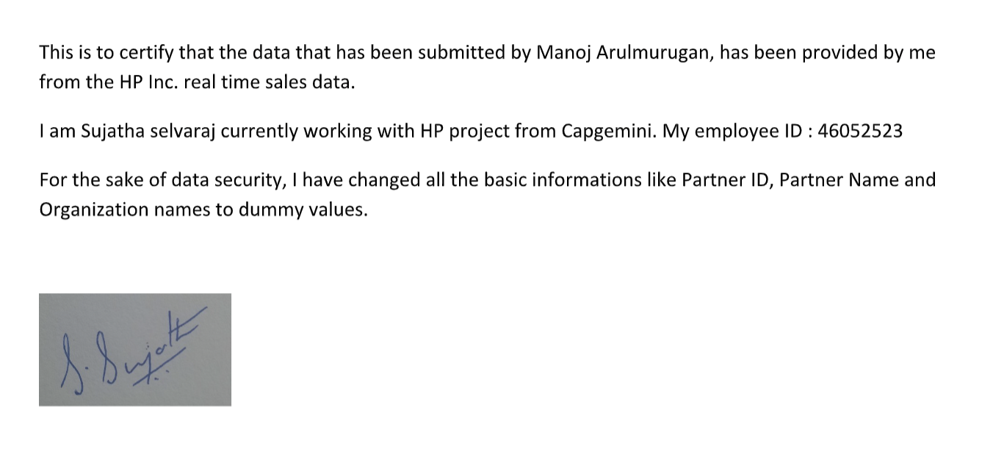

Organization Background
HP Inc. is a multinational technology company that emerged from the split of the original Hewlett-Packard (HP) in 2015. HP Inc. specializes in personal systems and printing products, offering a wide range of hardware and software solutions.
Backend technicians usually don’t have any information of how the sales and revenues are getting affected based on the data they procure and give for the business analysis team.
This person insisted that if they get to know which particular product group or geographical group of the buyers generate better revenue or sell more units, initially, using more preliminary methods, they could procure the sales transaction data in a more effective way.

Slide 4
Data and pre-processing
The procured data consists of sales details between ‘Power’ distributors, retailers and customers over the past 3-4 years.
For market security reasons, the names of the retailers, distributors, and customers would be changed or fabricated by the developer.
Important attributes of the Data:
Quarter: Denotes the quarter at which the sale happened. It could either be a calendar year or a Fiscal Year.
Product Hierarchy: Business Unit -> Chai Mapping -> Product Segment -> Product group -> Product Categories -> Product line
Geographical Hierarchy: Partner Market (Continent) -> Partner cluster (Cluster of countries) -> Partner country.
Total revenue of each of the purchase, in both the local currency and USD and the no. of units sold of the product.
Data Pre-Processing:
Remove all the useless columns – Transaction IDs, Currency Types.
Only one attribute from each of the listed hierarchies were kept.
The quarters in which the sale took place was converted to datetime format for time-series demand/revenue forecasting.

Slide 5
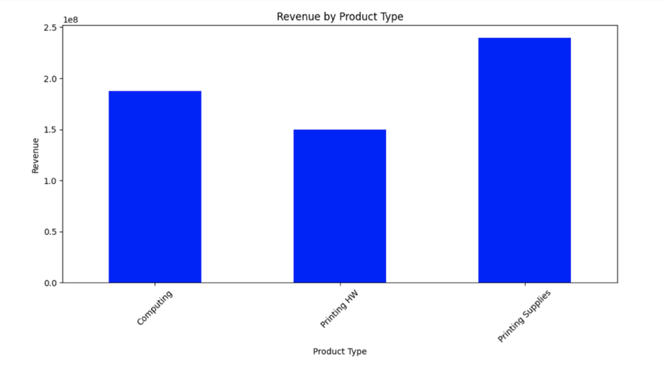
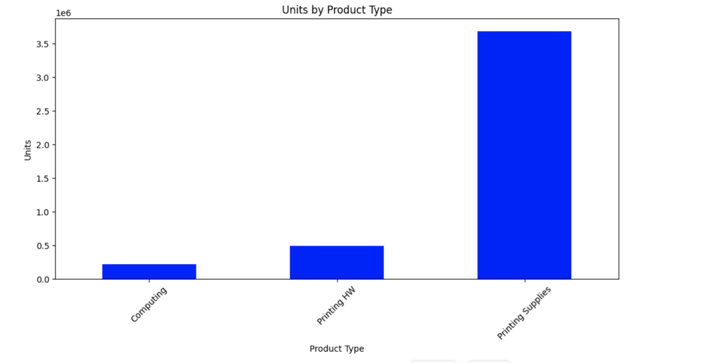
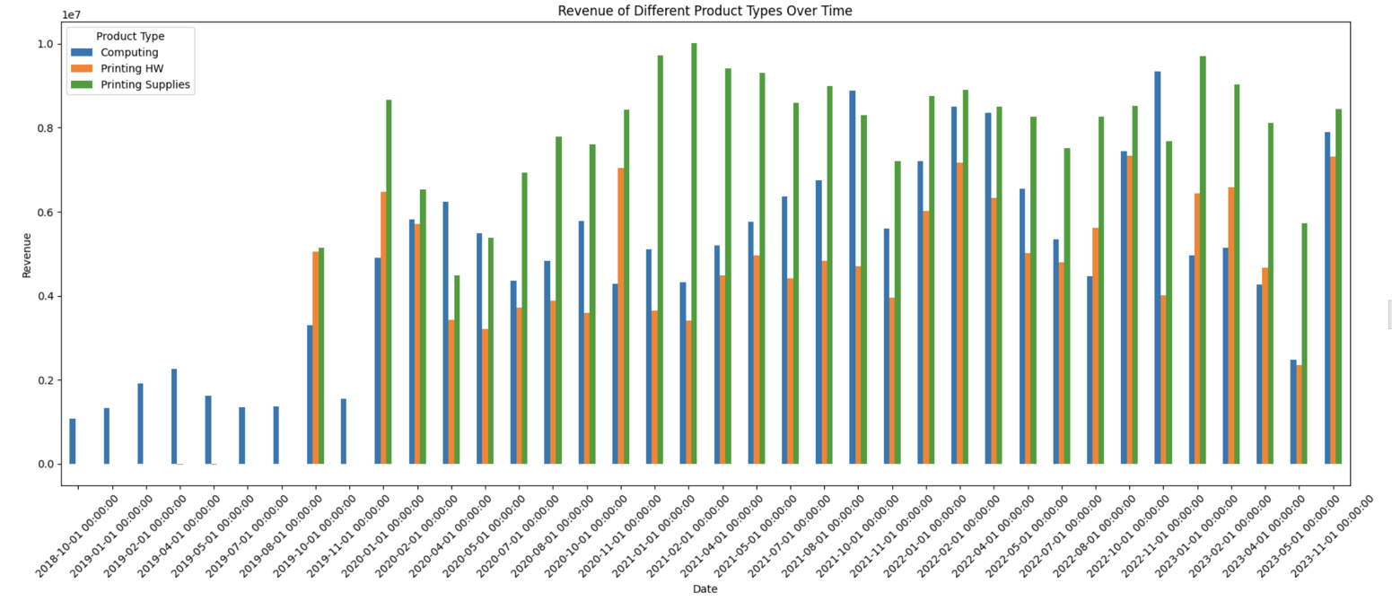
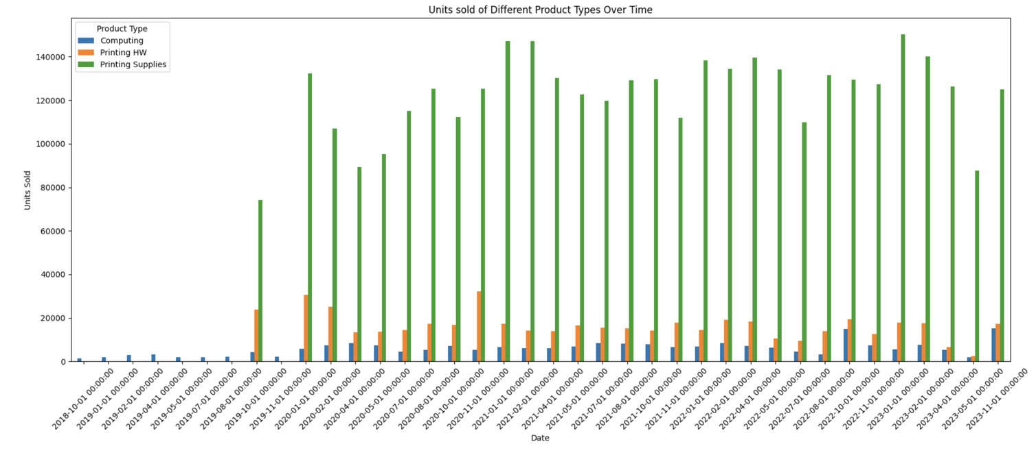
Customer segmentation

Slide 6
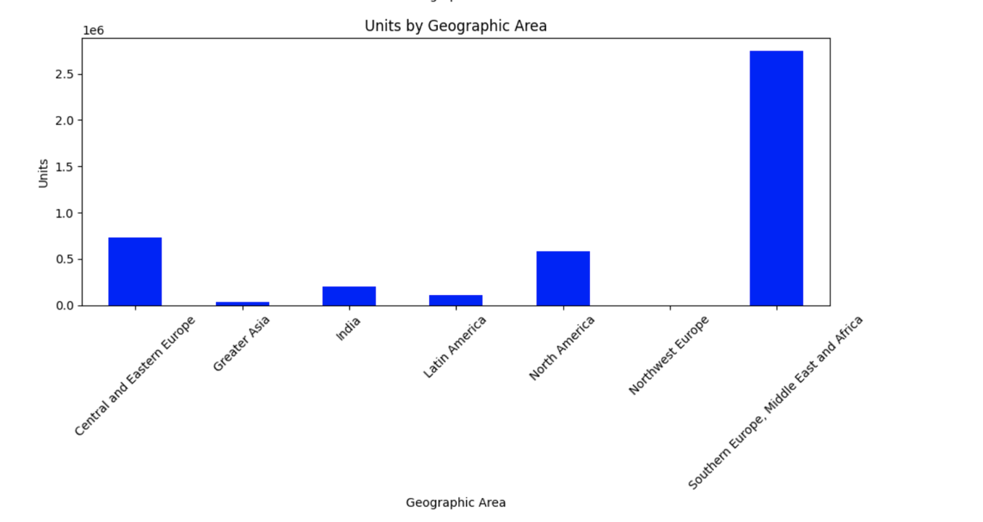
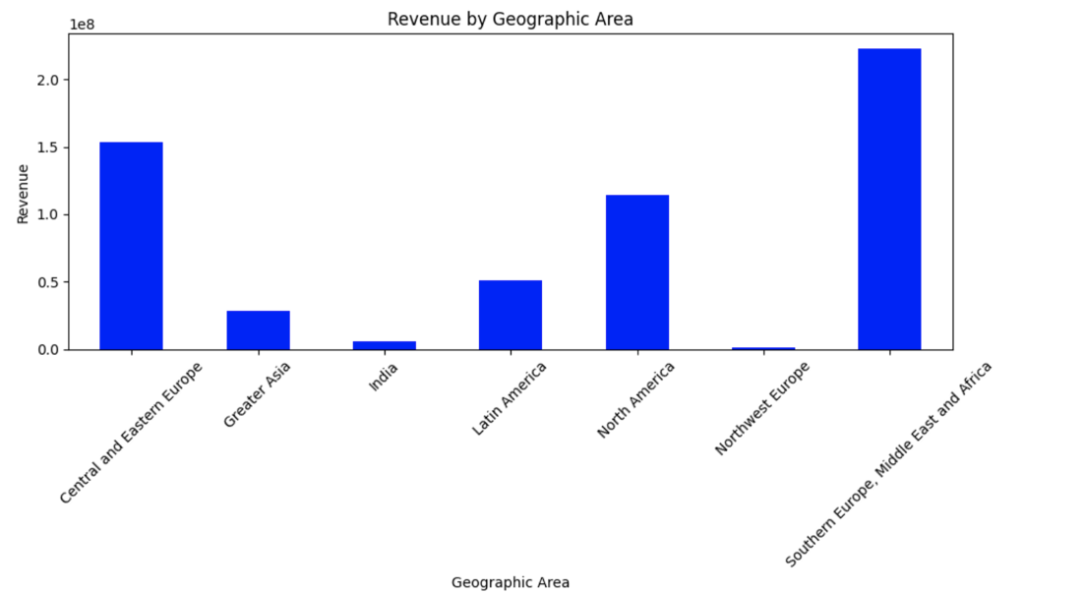
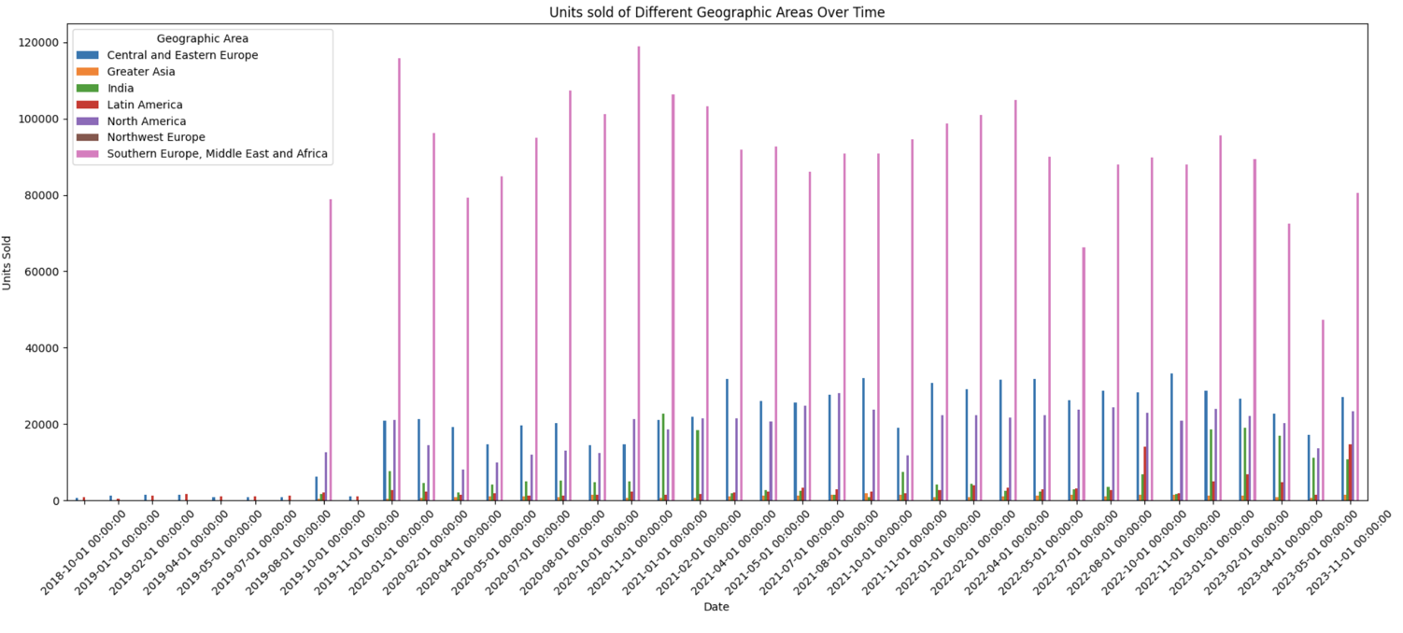
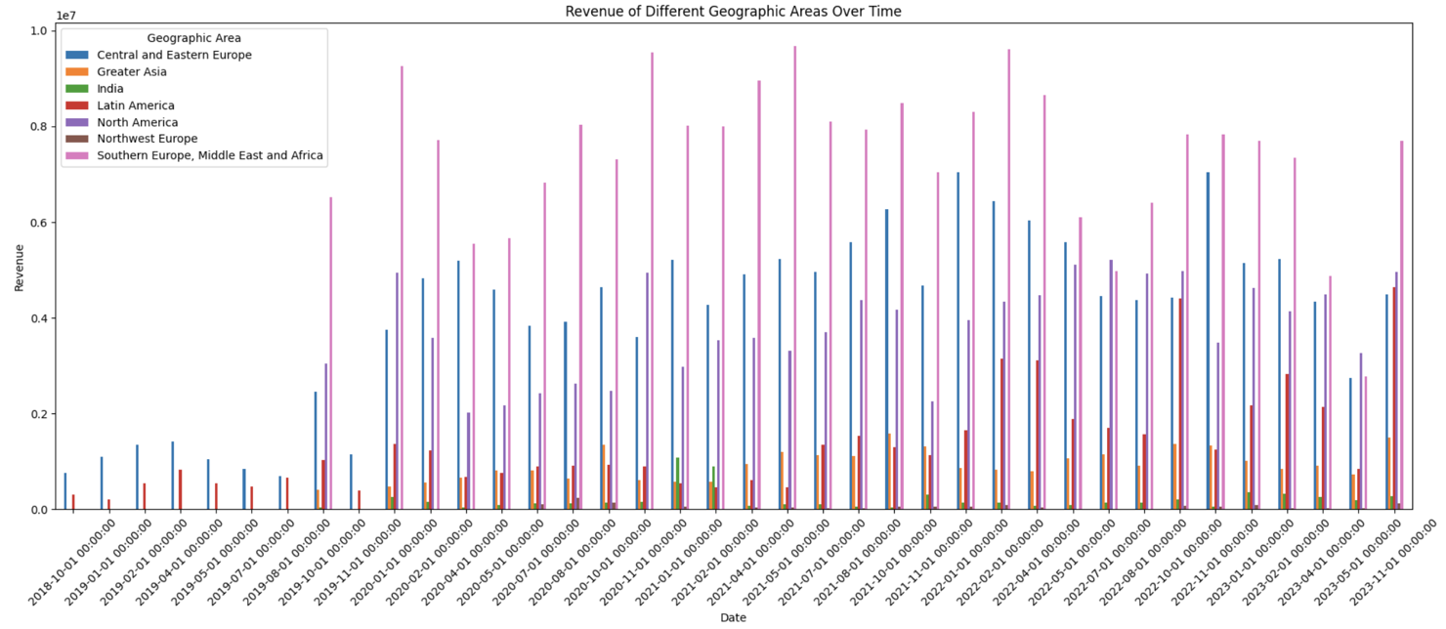
Customer segmentation

Slide 7
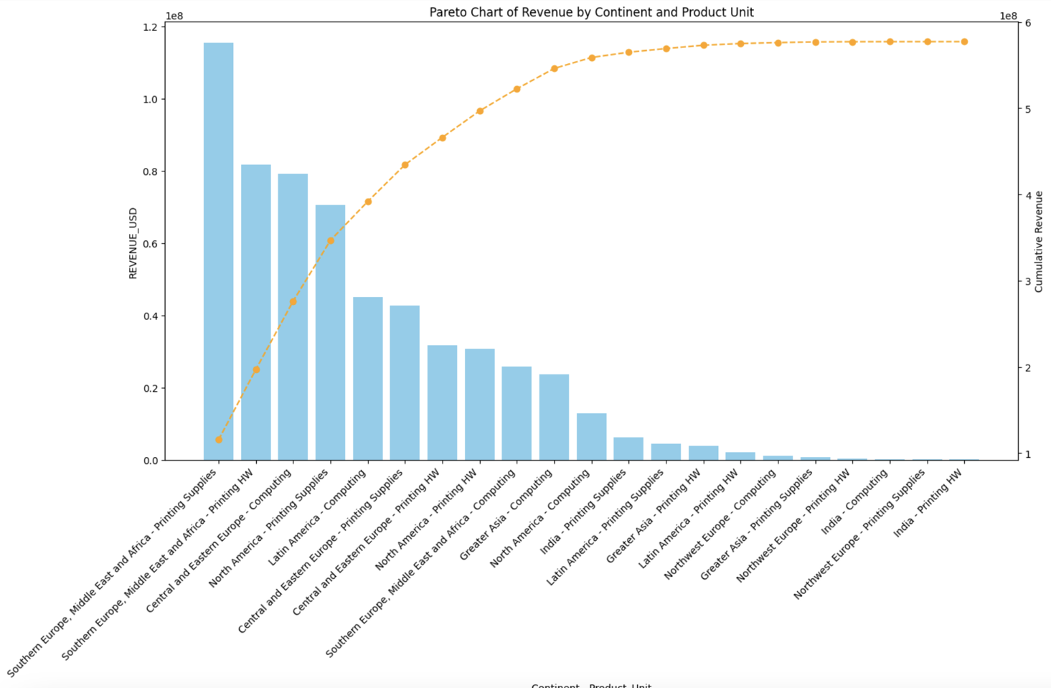
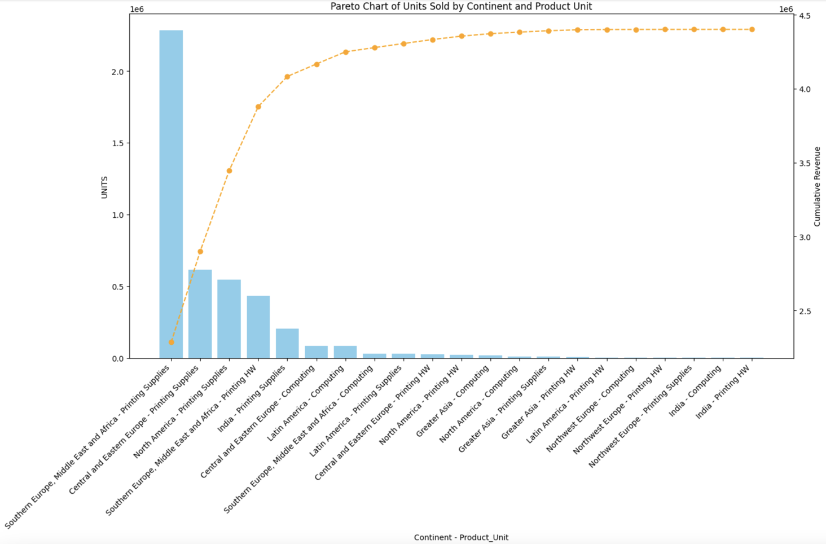
Pareto analysis
Pareto analysis involves identifying and prioritizing the most significant factors contributing to a particular outcome or problem using the 80/20 rule.

Slide 8
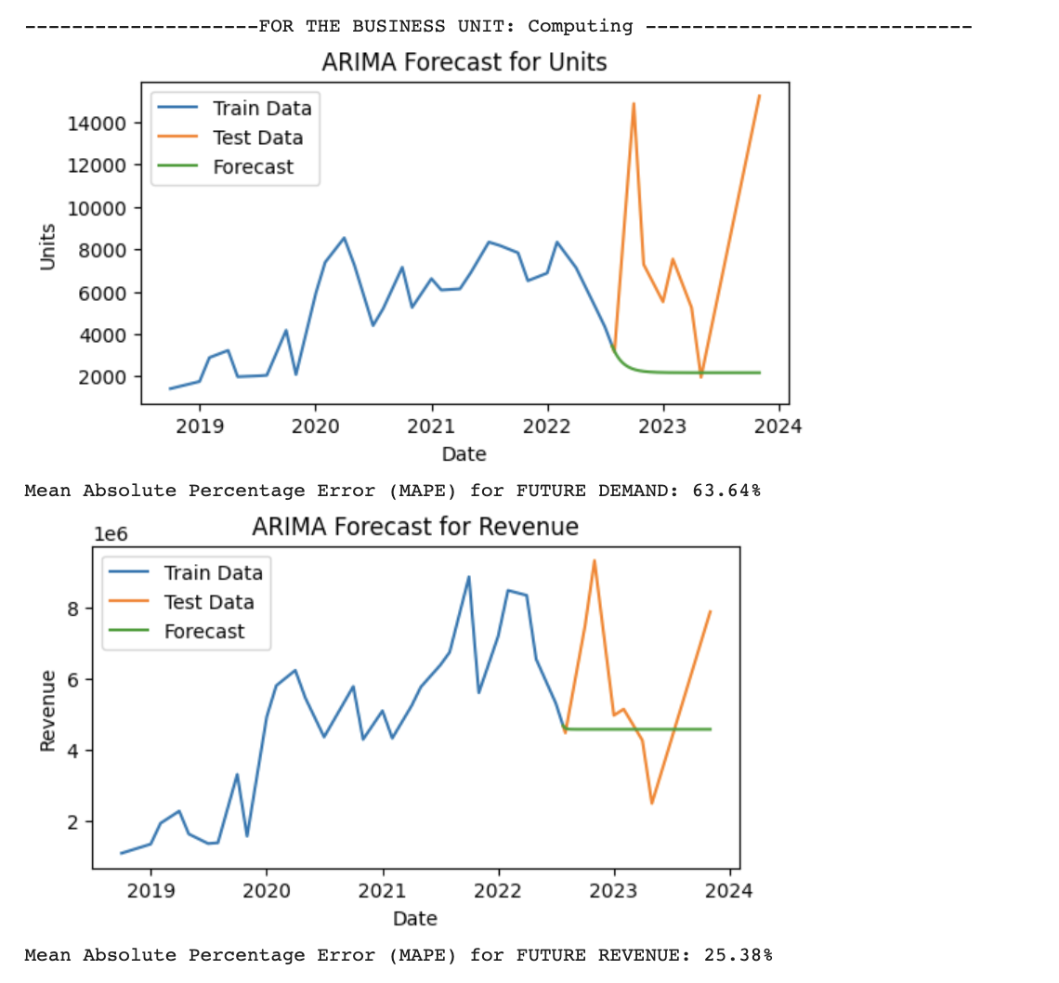
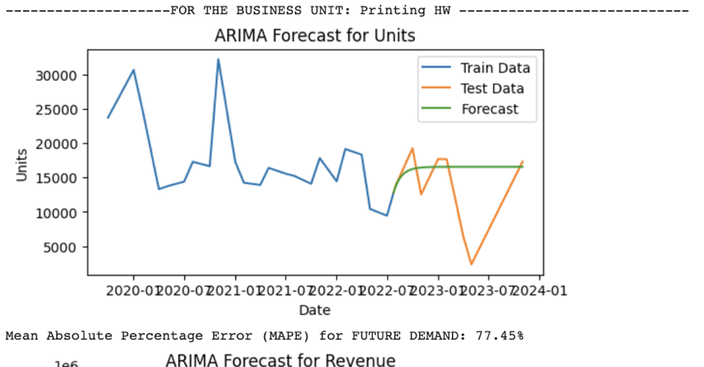
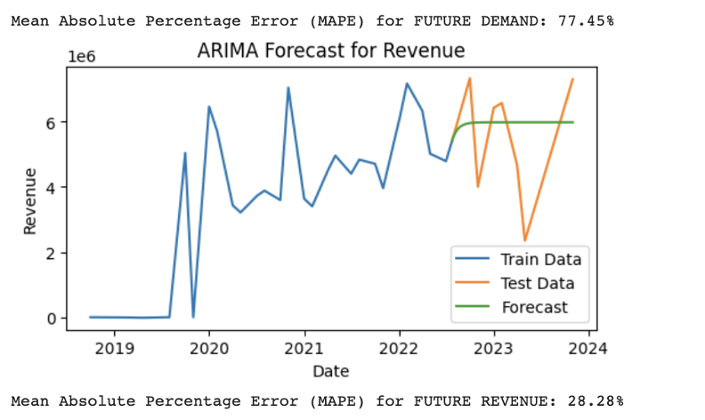
Demand and Revenue Forecasting
The time-series forecasting method Autoregressive Integrated Moving Average (ARIMA) was used to develop a model using the training set and was tested upon the test set to predict future trends.
Forecasting has been done on units sold for each purchase and revenue generated.
Predicting the future demand for No. of products sold and revenue in different geographical locations and for different product types.
MAPE measures the percentage difference between the forecasted values and the actual observed values. It is a measure of the relative accuracy of a forecast and is expressed as a percentage.

Slide 9
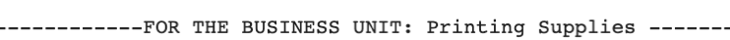

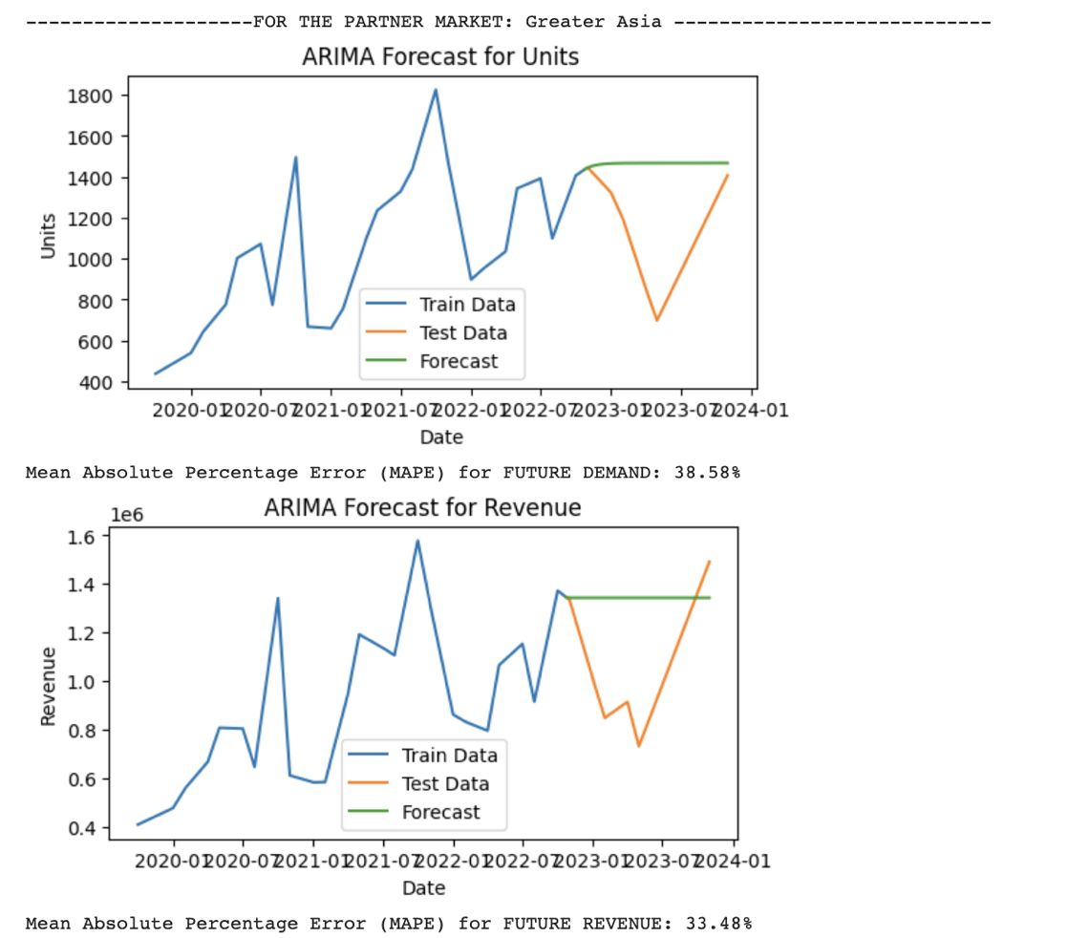
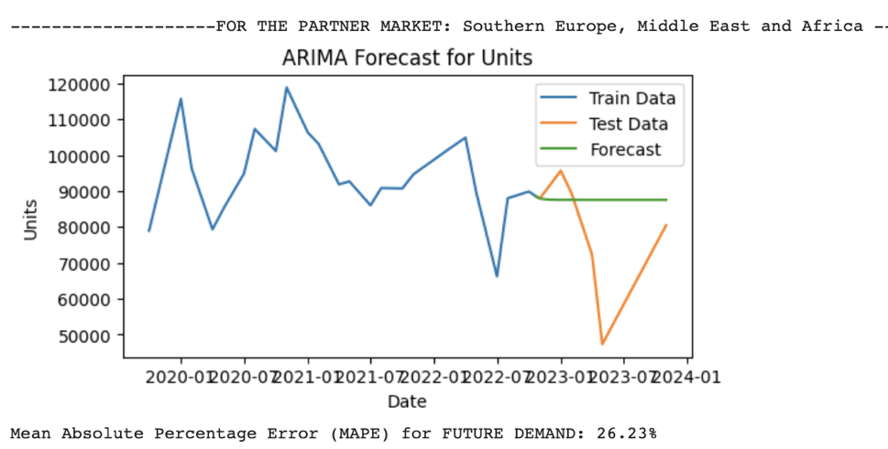
Demand and Revenue Forecasting

Slide 10
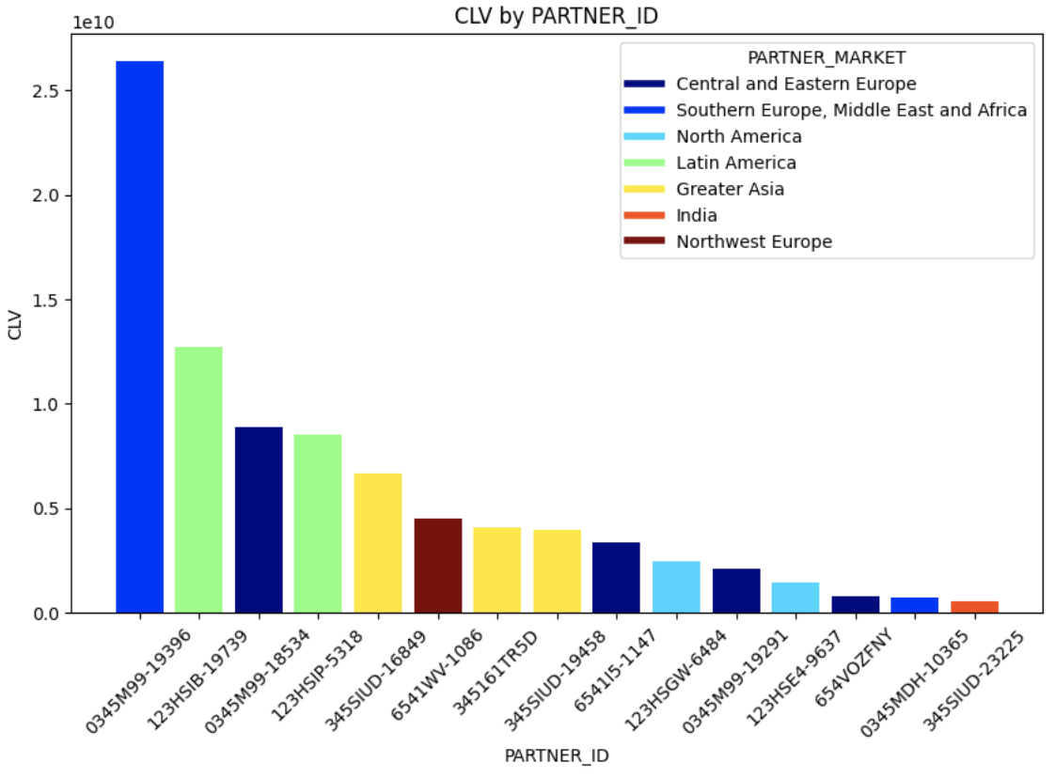
Customer Lifetime Value Analysis (CLV):
Important metrics ->
Average Purchase Value (APV) = Total Revenue / Total Number of Purchases
Average Purchase Frequency (APF) = Total Number of Purchases / Number of Unique Customers
Average Customer Lifespan (ACL) = Sum of Customer Lifespans / Number of Unique Customers
CLV = APV x APF x ACL
Determine which customer segments have the highest CLV. These are your most valuable customers.
CLV is a powerful metric for making data-driven decisions to maximize customer profitability and retention.
It's an ongoing process that requires monitoring and adjustment as your business evolves.
The following bar graph depicts the CLV values for all the 15 major individual partner customers who have bought products from HP over a 5-year time period.
Each graph segments which geographical location each partner customer belongs to and what type of products they buy.

Slide 11
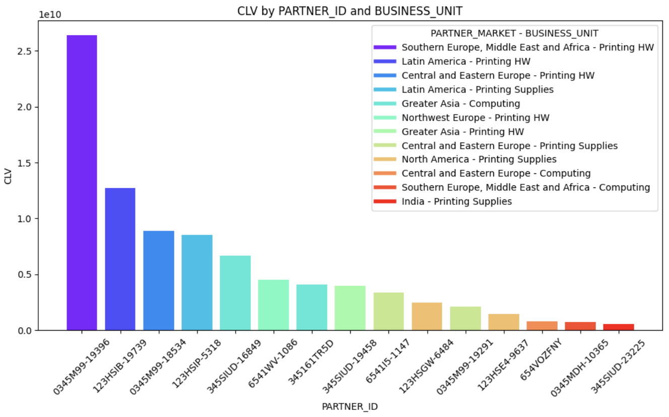
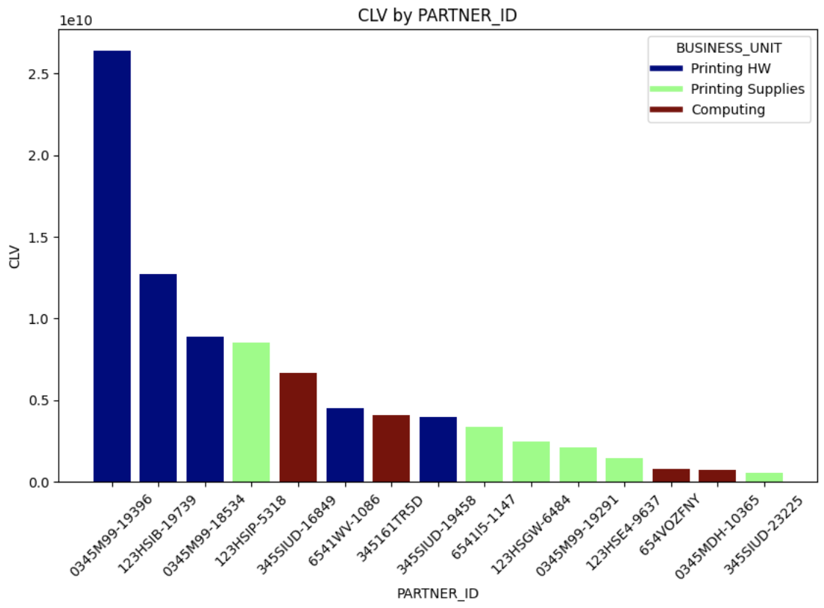
Customer Lifetime Value Analysis (CLV):

Slide 12
Interpretation of Results and Recommendation:
Customer and product segmentation:
Printing supplies revenue generated per item, is very less than computing or printing hardware.
Concentrate more company resources on producing printing hardware and computing products (assuming cost/effort to make all product units are similar).
From the Pareto Charts - customers situated in SEMEA and Central & Eastern European countries are the “vital few” (Top 20%) of all the geographical regions.
Allocate more company resources to an area common to these two regions, like setting up a large-scale production factory/warehouse in say a country like Turkey.
Demand and Revenue Forecasting:
Company can reduce overproduction and minimize excess inventory costs while ensuring that popular items are readily available.
Reduce operational costs by avoiding rush orders, excessive warehousing, and transportation costs.
Customer Lifetime Value Analysis (CLV):
Further increase profits by also concentrating on producing/distributing printing hardware supplies in SEMEA and Central & Eastern European countries. This setup in Turkey would get more products that the top customers want and in faster time.
These methods’ outcomes are easy to study, analyse and interpret, without the use of complex methods such as ‘Propensity to Buy’ attribute which are usually calculated by the company’s BAs. Thus, when backend data engineers use these methods to gain a wide variety of insights by themselves in quick time,

